Slide 1
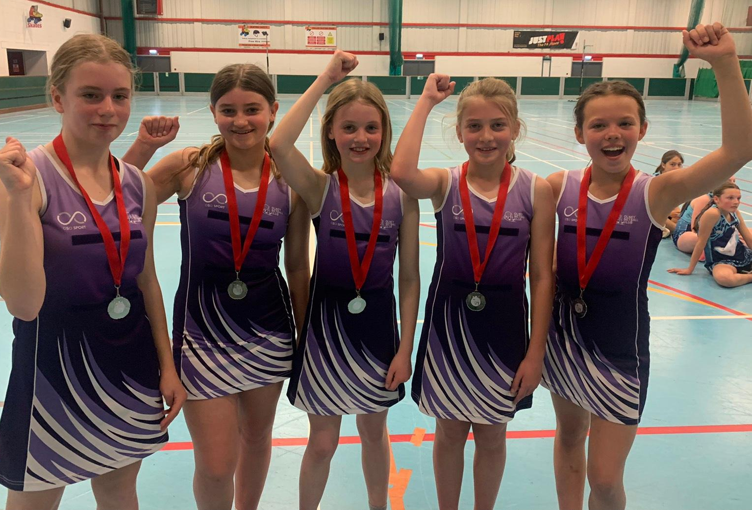
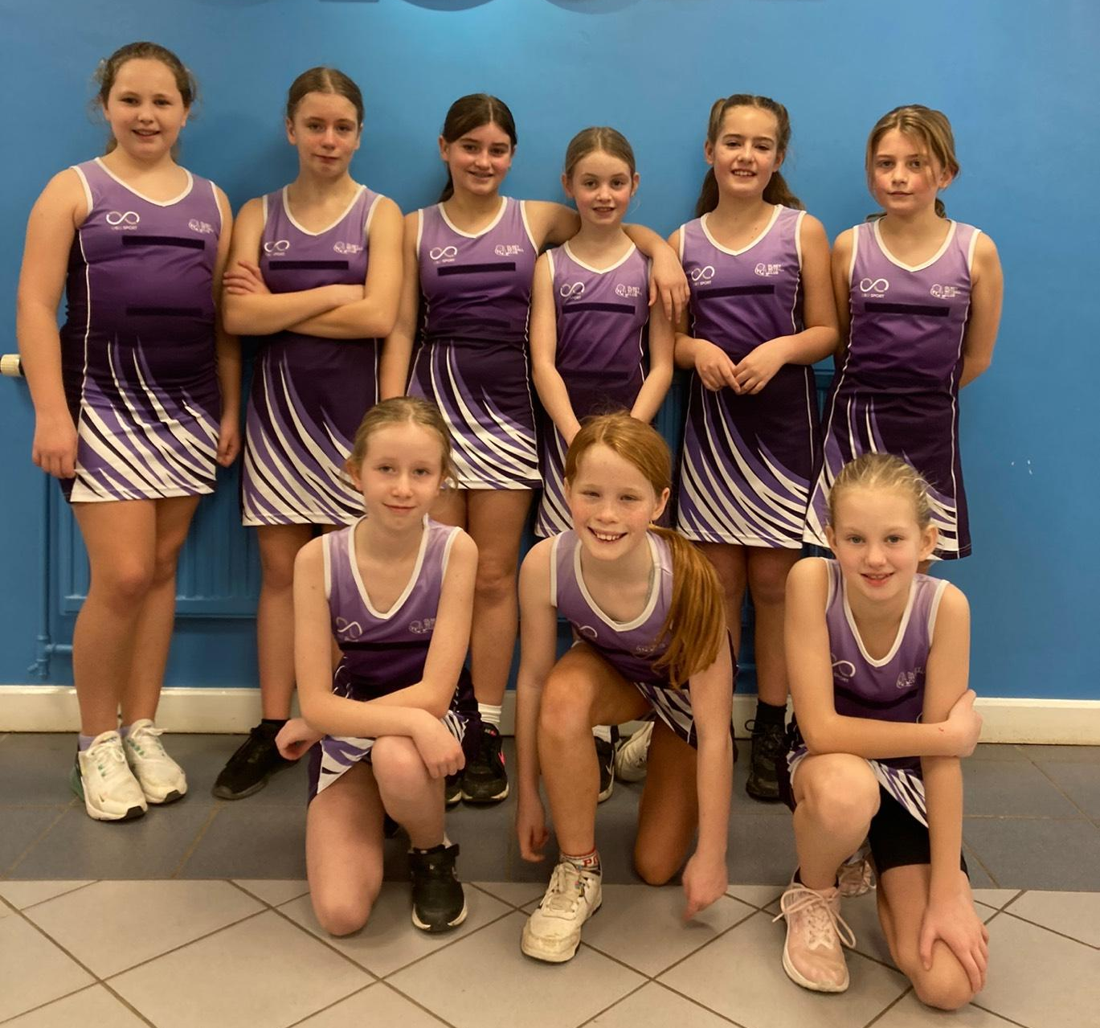
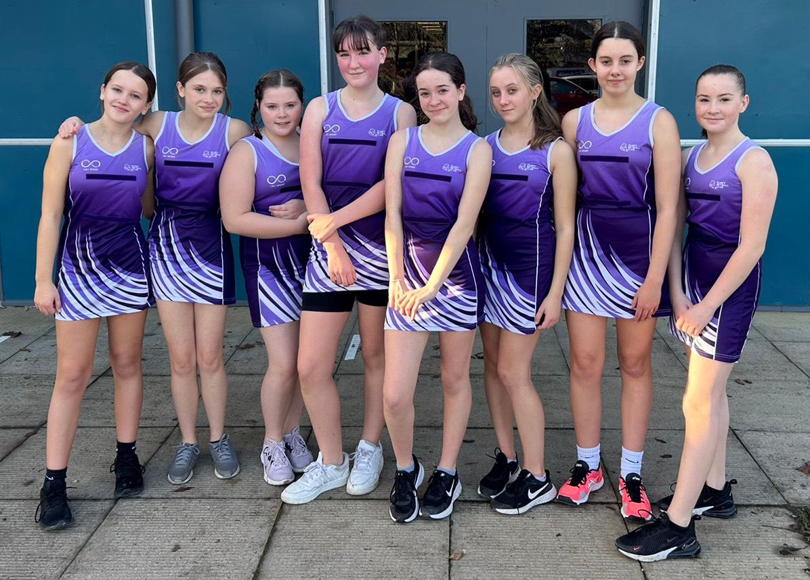
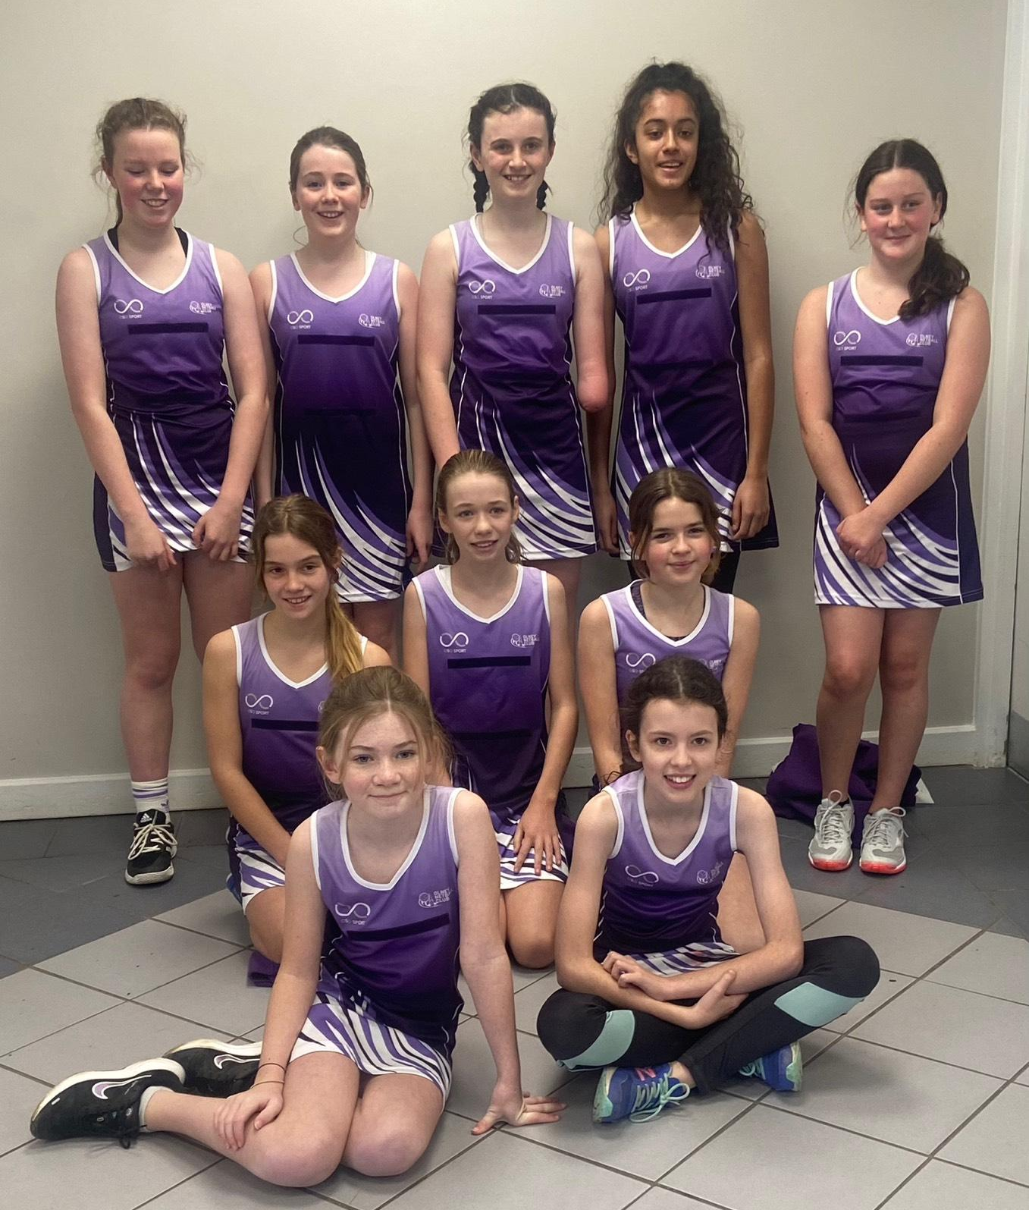
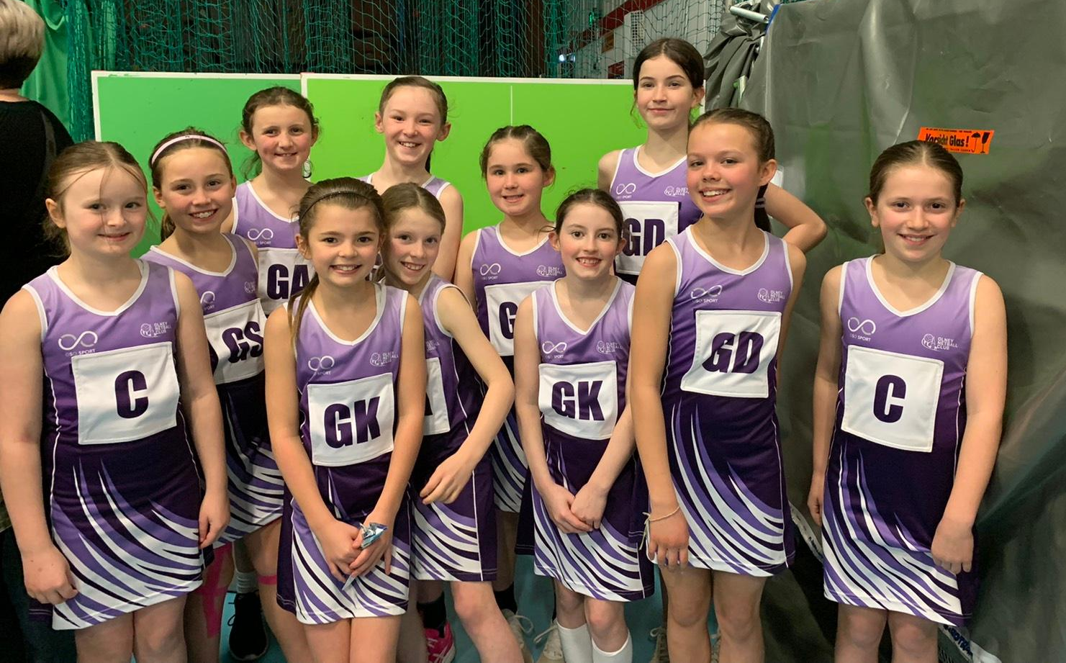
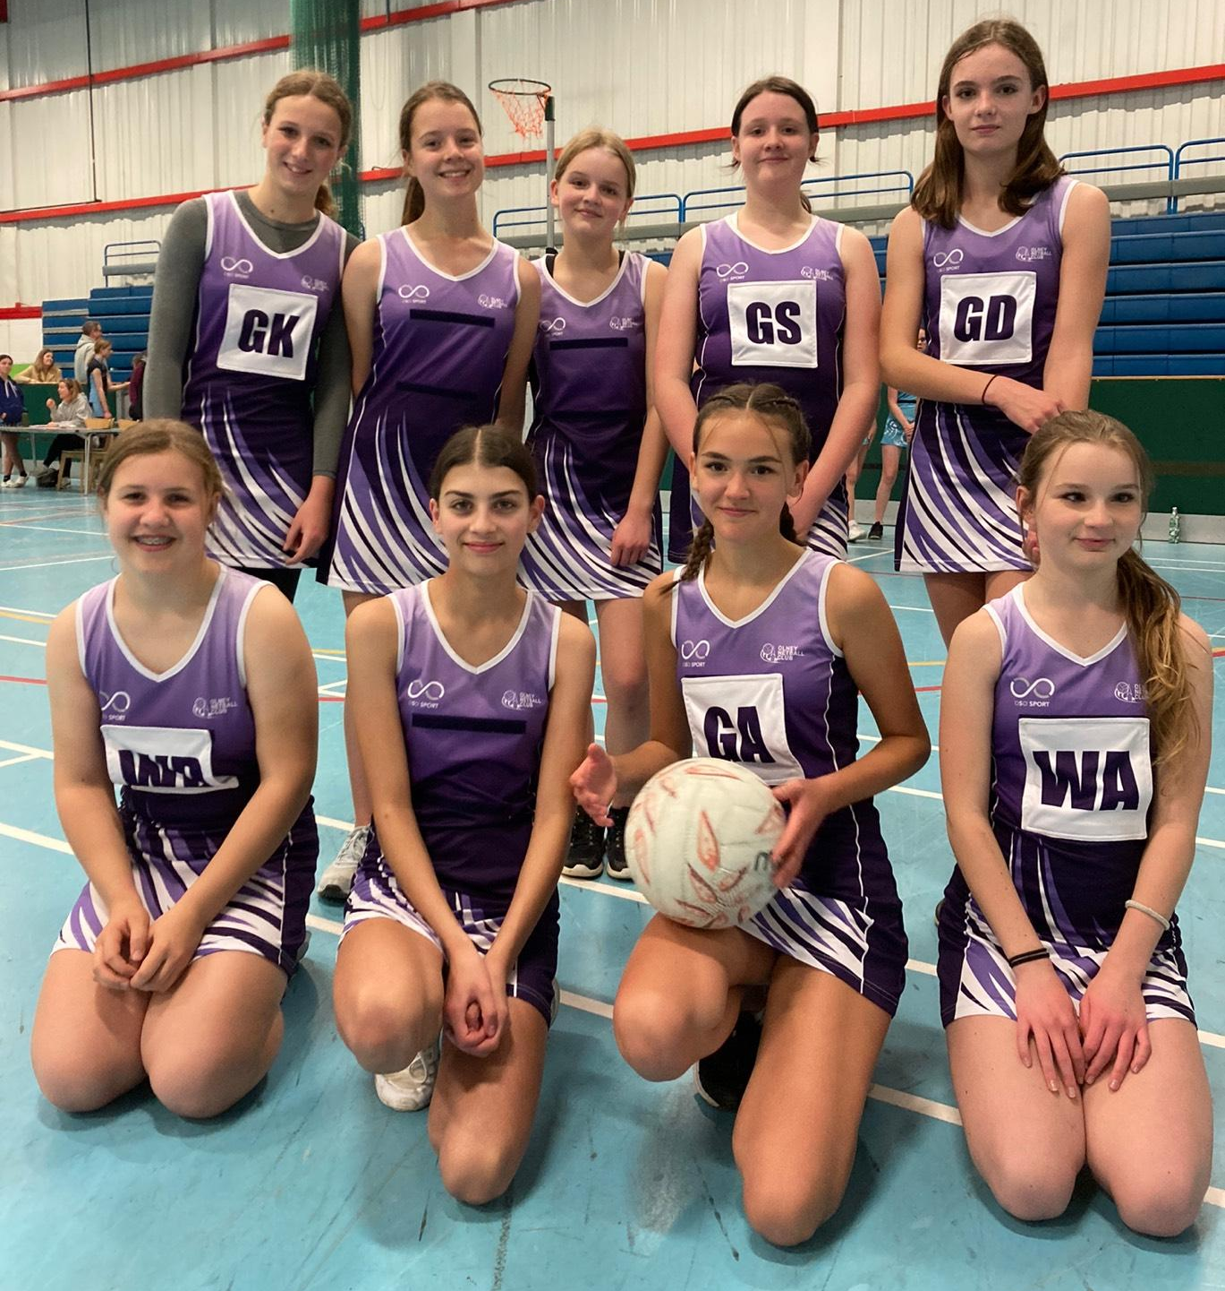
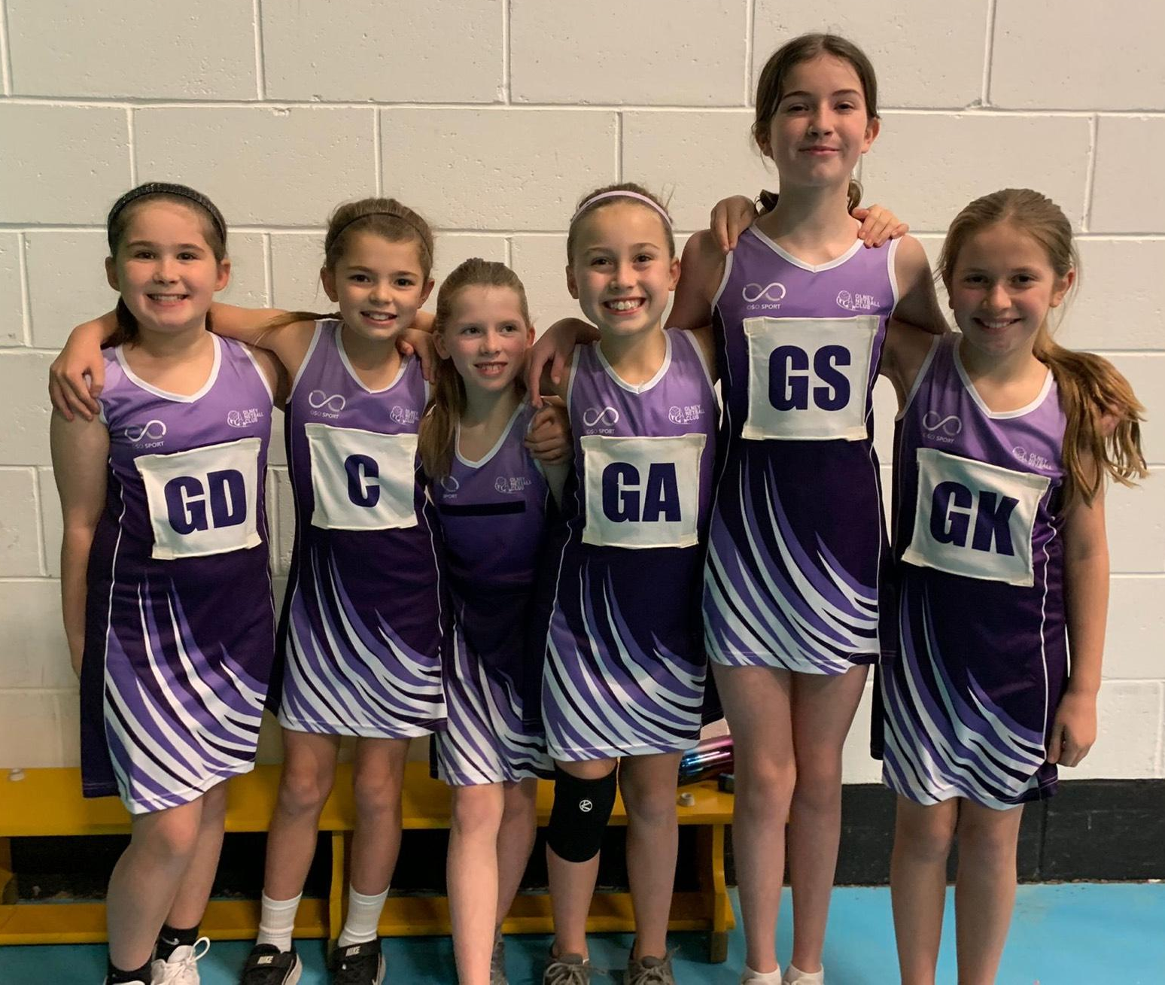
ONC AGM 2022/23 SEASON
Notes:
Welcome from Karena

Slide 2
AGENDA – 3rd July 2023
1. INTRODUCTION & CHAIR OVERVIEW Karena 2. TEAM REPORTS Emily/Karena,
Yvonne, Mandy, Sarah
3. PERFORMANCE ATHLETES Mandy
4. SEASON ISSUES Karena 5. NEW SEASON TRAINING PLAN, COACHES, TM’S Mandy
6. FINANCES, FUNDRAISING, FEES Mandy
7. RE-ELECTION OF COMMITTEE Karena
8. KIT SHOP Louise
9. lOOKING FORWARD Karena
10. CLOSING / AOB Karena
11. PRESENTATION OF AWARDS Coaches

Slide 3
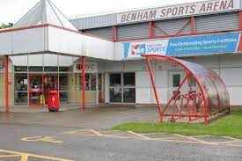
CHAIR overview of the 2022-2023 Season
94 playing members
xx on waiting list (Yr3-yr10)
8 teams with Squads of ~12/team
More teams than ever
Seniors: MKINL x 2 teams Juniors: NJNL x 2 U11 teams, 1 x U12, 2 x U14, 1 x U16
5 newly qualified Level 1 coaches (1 Level 2 coach leaving)
Notes:
KARENA
The Club continues to be popular and well populated
Increased from 70 fee-paying members to 94 players
We still have a Waiting list from Year 3 through to Year 11’s
We aim to have a squad of 12 for a team and a max of 24 at training. Max capacity is 96. We always lose some girls to college/university and the girls move up year groups so we can mainly take new players in Year 5. With training for Year 5’s on a different night we might be able to take some year 4s as well.
We’ve entered more junior teams in the Northampton Junior netball league at Benham to get them game play, and we have Milton Keynes Indoor league for our adults/young adults
Both of these leagues require us to provide umpires, so if anyone would like to learn to umpire please let us know. You can start on the Into Officiating course at 13.
Performance in leagues was mixed
Most of our teams finished low in the tables, except for U12s team and our U16s who finished mid table, and our Olney White team who came 2nd in their league.
New Coaches
Absolutely brilliant news that we now have 5 newly qualified Level 1 Netball coaches, who have been running the Year 5&6 sessions with Karena, and assisting Yvonne with the U12/U14/U16s. This has really helped us to spread the load for training and matches. Looking forward to seeing if anyone would like to advance to their Level 2.
Sadly, we are also saying goodbye to our Level 2 coach Yvonne, who has played with ONC for 17 years and more recently coached our U12/u14/u16. She is taking back some personal time and focusing on performance coaching. A huge Thank you for your time and commitment. We wish you well with your new pursuits.

Slide 4
So how have our Teams done?

Slide 5
U11 Galaxy (Yr 5s)
Our SQUAD
Anna Tennant
Ava Thorpe
Betsy Collins
Charlotte Fitzgerald
Eloise Winter
Evelyn Booth
Lilah Jeavons
Madeleine Bacon
Madeleine Smith
Rae Simpson
Rosie Sallabank
Summer Fallis-Taylor
Notes:
Brilliant squad. Great start on their netball journey
Thanks to coaches Emily and Maria, and TMs and parents for your support

Slide 6
U11 Meteors (Yr 6)
Our SQUAD
Abigail Souster
Annabelle Jessup
Ava Gascoyne
Brooke Parker
Coco Wale
Grace Parish
Isabelle Baxter
Isabelle Sceats
Isobel Warren
Matilda Williams
Oonagh Perkins
Poppy Ward
Seren Denoven

Slide 7
U12s
Our Squad: Cecilie Suitters
Emily Fitzgerald
Eva Bahomian
Holly Elworthy
Isabella McCloskey
Isabella Rook
Leonie Rosentranz
Lotty Stewart Amelia Lowe Evie Macdonald
Maya Patel
Notes:
Summary:

Slide 8
Olney U14 Galaxy
Our SQUAD Amelie Belsom Arabella Soul
Sophie Bodger
Charlotte Kenward
Evie Winter
Grace Young
Isabel Child
Jessica Adamson
Lauren Clements
Lily Newberry Olivia Millman
Libby Oxley
Rosie Newberry
Nell Westwood
Notes:
Summary:

Slide 9
Olney U14 Meteors
Our SQUAD Jess Anderson
Carys Bacon
Elise Cooksey
Martha Donaghy
Giselle Cheshire
Caitlin Greaves
Jasmine Butler
Anya Ledsom
Mikayla Martey
Emily Paynter
Tazmin Maarman
Tilly Tompkins Katy West
Notes:
Summary:

Slide 10
U16s
Our SQUAD Coco Broyd
Eden Young
Evie Munday
Evie Stead Connie Keeping Katie King
Cerys Mather
Milly Ward
Caitlin Pearson
Freya Walstrom
Emily West
Notes:
Summary:

Slide 11
Olney White
Our SQUAD Millie Corley (C) Polly Bennett Molly White
Liberty Young
Scarlett Young Mia Walstrom Mandy Mistlin
Hannah Merry Ffion Mather
With support from Katie King, Cerys Mather, Caitlin Pearson, Connie Keeping, Evie Munday and Anastasia Younger-Gray (before moving to Purple)
Notes:
Great season, Finished 2nd in MKINL Div 2. Now have a play off next week vs second to last placed team in Div 1. We’ll struggle to field a team so may not be promoted, but they deserved it.
Not always easy to field a team over the last few months (long season into exams) and had some great support from U16s
Gelled well as a team with some core strength in each third of the court and breadth of skills to cover shooting and defending vacancies when needed. We just didnt have the consistency of a strong partnered shooting circle or defending circle for the last few/key matches and the top placed team had a very good tall GS.
Call out to the following: POM awards most often to liberty, scarlett and millie and was great to have Polly back in defence for us this year. We’ll also lose Mia, Molly, Scarlett, Ffion and Hannah - so a big thank you to them. Good luck with your results and hope you continue your netball wherever you go next.
Really enjoyed seeing this young team play strong fast netball, their versatility on court, and learn to play under pressure from some tougher teams. Even allowed me to get a few games in. Well done Whites, proud of you.

Slide 12
Olney Purple
Our SQUAD Sarah Parker (C)
Michele Attwood Emily Wyatt Ruby Brock Georgia Richardson Anna Williamson Maddie Murphy Alexis Peters Anastasia Younger-Gray Charlie Scowen Mhairie Taylor
Notes:
Finished bottom of the MKINL prem league
Injuries affected the team but breadth of skills enabled a variety of players to take shooting roles
Skilled players and some great match play but difficult to compete at this level without a tall GS and all available to train together to work on the difficult elements of play

Slide 13
Congratulations to our players on the England Netball Performance Pathway

Slide 14
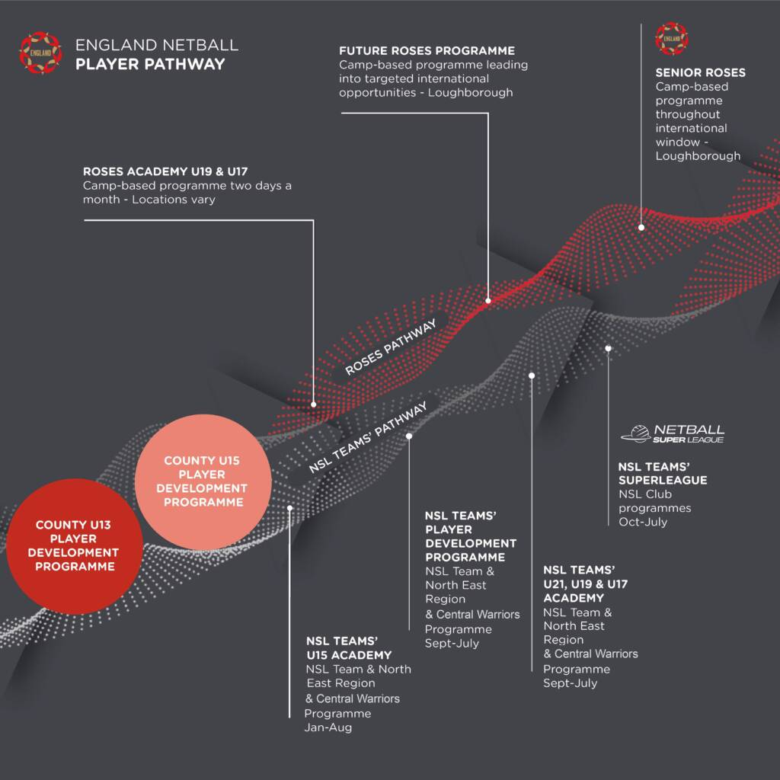
EN Performance Pathway
U11 Isabelle Sceats, Abigail Souster, Matilda Williams
U13 Olivia Millman, Abi Snow, Lotty Stewart
U15 Katie King
Emily Wyatt (+ u16/u19 MK Dons regional)
Notes:
Olney Netball Club endorses talented players to trial for the County netball programme, which is the first step on the England Netball performance pathway.
We are also a feeder club for girls to trial for Regional teams (MK Dons or MK Netters or Team Beds or Northants Storm) which then play in tougher leagues than the club teams.
From this exposure some may then trial and get into franchise or superleague programmes e.g. for London Pulse, Saracen Mavericks or Loughborough Lightning.
We are very proud of all our players, and would like to congratulate those that got selected for County this past year……..
And Emily Wyatt who has been training with London Pulse.
if you want any more information on this please talk to Mandy Mistlin. She is now the Beds County Performance Lead (running the county programme there) and a Regional Coach with Team Beds .

Slide 15
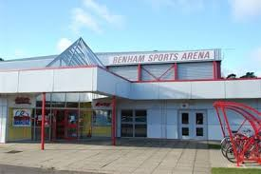
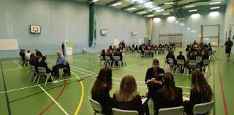
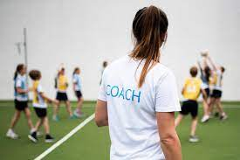
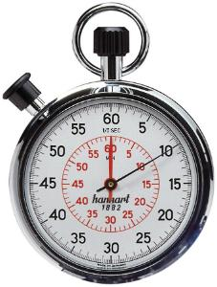
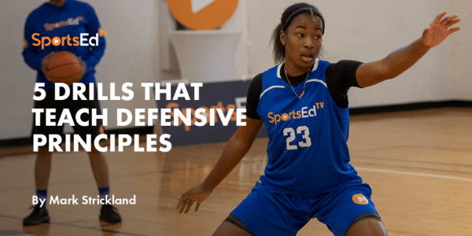
Difficulties this season……
ReSPOND on
Notes:
Slow responses on Spond and last minute changes meaning coaches have to put a lot of time in trying to sort teams every week. This is the one thing we ask of you, Please RESPOND quickly on SPOND. It saves us a lot of time and stress.
Leagues and Venues: Benham league under new management, some hiccups and limited match play for younger age groups MKINL leagues some venue issues, longer season, no summer league. Our own venue is only one court, so when we have a lot of girls at training we don’t have a lot of room to occupy the girls when not on court.
Coach availability and time: we have been building our coaching squad but a number of us have other teams and coaching commitments. This season not been able to arrange umpiring or basketball training visits, so we’ll try again this season. If anyone has contacts and wants to arrange this let us know. Also hoped to plan a year 4 taster and would like to run back to netball for adults. We’ll keep reviewing how we can deliver more.

Slide 16
NEW Training Plan
DAY | TIME | YEAR GROUPS from Sept 2023 | LEAGUE AGE GROUP
Monday | 5-6pm | Yr 6/7 | U11s and U12s
Monday | 6-7pm | Yr 8/Yr 9 | U14s
Monday | 7-8pm | Yr 10/11 | U16s
Monday | 8-9pm | Yr 12/13 + Seniors | MKINL Championship (Olney Purple) MKINL Div 2 tbc (Olney White)
Wednesday | 5-6pm | Yr 5 | U11s
Our Coaching Squad for the new Season
Mandy Mistlin
Karena Scowen
Charlie Scowen
Emily Winter
Maria Tennant
Eimear Fitzgerald
Becky Stewart
Julie Paynter
Notes:
Because of the increased numbers we now have in the club and a change of coaches we need to revise our training plan for the new season. We propose to combine the Year 6’s and Year 7’s as they are all ‘netball’ ready, separating them from the Year 5’s who are coming in new to the club and not necessarily as familiar with netball, or with the same level of catching and movement skills. Year 5s would be on a Wednesday at 5pm, the only slot the school has available.
We will combine the U13/u14s together in training as they will both play in the U14 league. We have a big cohort now in u16 of u15s and u16s who will play as one team in the U16 league.
8-9pm will be for the Yr 12/13s and seniors who will then play for our adult teams. Some selected players from the U16s will be invited to additionally train in this slot and play for the senior teams.
We have a much bigger coaching squad now, so will work out who will coach what over the next few months. This is great as it means we can cover each other and offer the players a different coaching perspective from different coaches. Our ask of you, Please remember that we are all volunteers and that the club wouldn’t run without these amazing people.

Slide 17
Our Team Managers for the New Season
U11 Yr 5 TBA
U11 Yr 6 Emily Winter
U12 TBA
U14 Galaxy Lisa McCloskey
U14 Meteors TBA
U16 Helen Donaghy
Olney White Millie Corley
Olney Purple Sarah Parker
Notes:
As well as the coaches, our Team Managers are also volunteers.
They help the coaches manage the teams on match days. Corralling the players, messaging, ensuring we have bibs and balls and first aid kits and doing any paperwork required of the teams.
Thank you to all those that are moving up with their children to be TM for the next age group up. We will have a vacancy for the U11 Yr 5’s which will come from a new recruit. If you would be willing to be TM for U12s or U14 Meteors (Y9) please let us know

Slide 18
Please fill in the Google Form for INTENTION to Rejoin ONC
https://forms.gle/3t4MU6aLETiSe4CS9
Posted on SPOND to ONC club
Notes:
We need this so that we know numbers in the different age groups, for training plans, recruitment, number of teams to enter into leagues and budgeting

Slide 19
The Money bit…..

Slide 20
Finance Update
Olney Netball Club Accounts 2022-2023
Opening Balance | 6,757.40
Uncashed cheques
Current Balance | £5,505.45 | 6,153.45 | Actual Balance
Profit/Loss | -£1,251.95
 | Income | Expenditure | Difference
ONC fees and EN refunds | £11,314.00 | £323.00 | £10,991.00
Training and Kit Costs | £0.00 | £8,702.78 | -£8,702.78
League/Match Fees | £40.00 | £2,425.00 | -£2,385.00
Development Courses | £187.50 | £976.77 | -£789.27
General Club | £500.00 | £965.20 | -£465.20
Fundraising | £119.30 | £20.00 | £99.30
Exceptional Items | £0.00 | £0.00 | £0.00
Sub totals | £12,160.80 | £13,412.75
Notes:
We started the year with a healthy opening balance but expected much greater outlay on expenditure. We have maxed out on number of players the club can accommodate so we benefited from more fees in, but as you can see our expenditure is still greater than our income. We also benefited this year from a bursary from North Bucks county against our coach development costs, sponsorship from the Cherry Tree for our AGM/trophies and a lot of holidays in May where we didn’t pay court hire!!
We do have increases in court hire costs, and we’ll have an extra session to pay for (as you’ve seen from the training plans) and league entry fees for next season will go up, but we will offset those against the larger starting balance we’ll have. which means no increase in 2023-2024 Club fees . We will also be using any remaining balance against coach and umpire development and guest coaches to benefit the players.

Slide 21
Netball Fees for 2023-2024 Season
England Netball fees will be:
Over 18 | £39
Under 18 | £18
Under 14 | £10
Under 11 | £7
Social & Supporting | £15
ONC fees will remain at:
Juniors U11-U16: £130
Seniors Yr 12+: £140
No 2023-2024 membership fee will be charged
Notes:
So, The netball fees for 2023-2024 season that you need to pay are divided into two.
The first part of the fees is what you pay to Olney Netball Club. Just a reminder: This pays for us to hire training venues, enter leagues, pay match fees, pay for coaches and umpires, their professional qualifications, buy training equipment and match dresses and admin bits and bobs. It is a one-off annual fee and we don’t ask you for any other payments during the year.
We propose to keep the fees the same for next season.
The second fee you need to pay is for England Netball Membership. This one you pay direct to England Netball (via the Engage system) - you’ll usually get an email reminder from them for this.
This payment consists of 3 parts, a fee for England Netball based on age, a small fee for the County your Club is in (North Bucks) and a small fee for the Region (South).
Both North Bucks and South Region have waived their fees again this year, EN have raised their fee a bit. Importantly, this includes EN insurance. You also get reductions on courses, tickets, and things with partner agencies.
EN Membership for All TMs and coaches is paid for by the club, in lieu of the role they play. Coaches with children in the club will not be charged ONC club fees, in lieu of their coaching time.
We will issue all information ON SPOND to remind you of payments for fees. If anyone is going to struggle with ONC payments and needs a payment schedule please contact our treasurer, mandy Mistlin at olneynetballclub@gmail.com

Slide 22
Fundraising
£85.99 paid to ONC this season to date
https://www.easyfundraising.org.uk/causes/onclub/
Notes:
Not needed any specific fundraising this year, like we did for kit last year.
Easyfundraising is 24/7 fundraising boost that costs us nothing. All you have to do is sign up to our fund “olney netball club” and activate the donation reminder, then whenever you are online shopping you will be told if you can earn a free donation. You click on that pop up, you carry on shopping as normal and we get a free donation.
ONC has 94 players, with parents/guardians, grandparents etc and yet only 43 people have signed up and support us through their online shopping habits. This can really mount up for us if you’re booking holidays, paying insurance, travelling with work etc, so please consider doing this.
PLEASE SIGN UP using this link. https://www.easyfundraising.org.uk/causes/onclub/ We’ll repost it on spond after the AGM

Slide 23
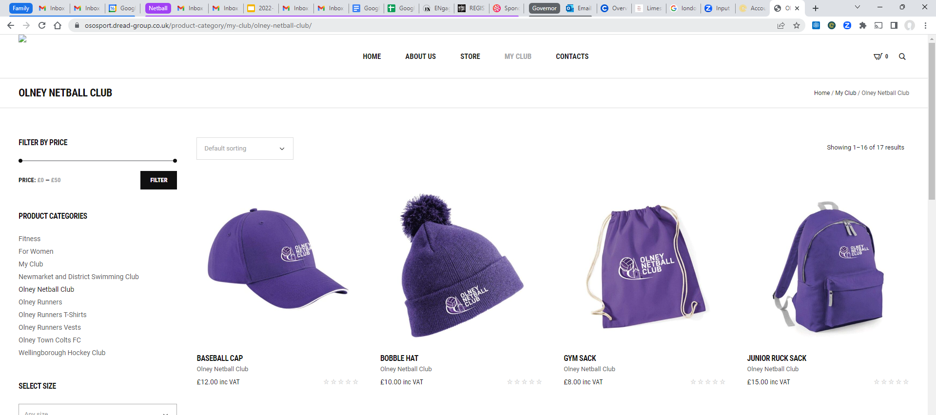
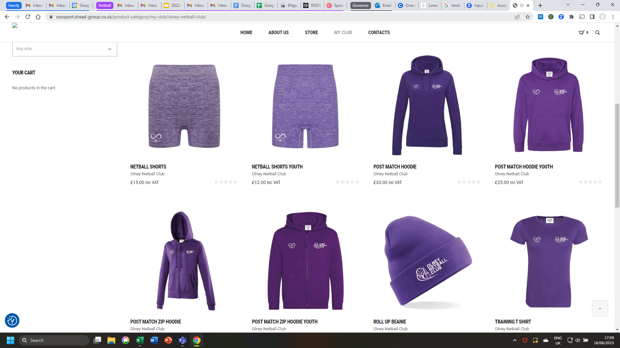
Kit Update
Working with OSO Sport, Local supplier to OFC and ORFC and now ONC
A full set of new team kit was designed and made available via our own web page for the start of the 2022/3 season by the provider OSO Sport, local to Milton Keynes.
Each player was provided with a new netball dress. Nearly a hundred dresses were distributed to our players!
Hoodies, training tops and vests, netball shorts, caps, kit bags and other kit accessories were made available to buy online, and personalise with each player's initials.
Training tops and hoodies were most popular.
There were some teething problems with the website, but they have now been sorted out.
Notes:
As you may know, the Club pays for all dresses and we had a new supplier and design this year. We also now have an online shop, courtesy of OSO Sport, where you can purchase a number of branded items.
Most popular have been training t shirts and hoodies.

Slide 24
The People bit…..

Slide 25
(Re)Election of the ONC committee
Role | Committee Member | Re-elect/ Standing Down | Propose
Chair | Karena Scowen | Re-elect
VC/Safeguarding | Michele Attwood | Re-elect
Treasurer | Mandy Mistlin | Re-elect
Secretary | Helen Bacon | Re-elect
Kit | Louise Ledsom | Re-elect
Team Managers | Sarah Parker (Purple) Mandy Mistlin (White) Vacancy (U16s) Helen Donaghy (U14 Meteors) Ann Winter (U14 Galaxy) Lisa McCloskey (U12s) Cindy Parker (U11 Yr 6) Emily Winter (U11 Yr 5) | Re-elect Standing down Standing down Standing down Standing down Standing down Vacancy | Millie Corley Helen Donaghy Vacancy Lisa McCloskey Vacancy Emily Winter
Social Media | Mia Walstrom | Standing Down | Vacancy
Notes:
For the mandatory committee roles (Chair, VC/Safeguarding, Treasurer, Secretary) all incumbents are happy to stand for re-election.
We have had a few new TMs take over teams this year and all are now happy to roll over to the next team up for the new season.
Will need a new social media manager for the club. Any volunteers?
The committee were nominated and seconded and A majority vote supported the re-election of candidates.

Slide 26
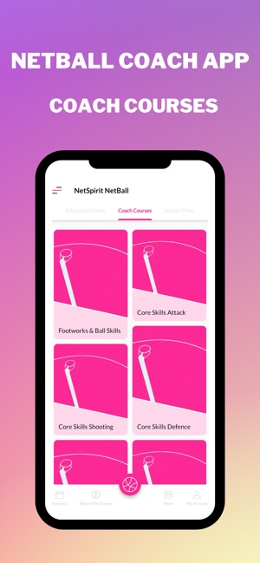
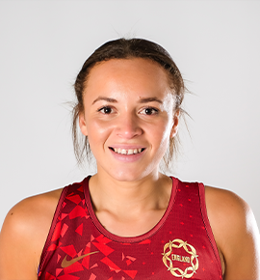
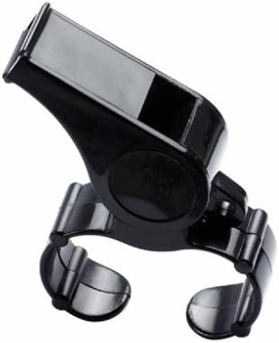
The Year Ahead
July 28 - Aug 6
Notes:
We need more Umpires. If any girls 13+ would like to pick up a whistle and train as umpires and then umpire Olney junior league matches please let us know. It pays!!
We are also going to focus on helping establish and keep upskilling our coaches. They all now have access to a coaching app to help with ideas and progressive skill drills.
And we hope to invite some guest coaches to run our sessions, e.g. England Rose and Loughborough Lightning player Hannah Joseph, and Basketball coaches.
We have the Netball world cup starting on….Fri, Jul 28, 2023 - Sun, Aug 6, 2023. Sky Sports and NOW broadcasting every match
If there is anything else you’d like to suggest or better yet, get involved with and organise, please let us know.

Slide 27
THANK YOU ALL FOR COMING
AOB?

Slide 28
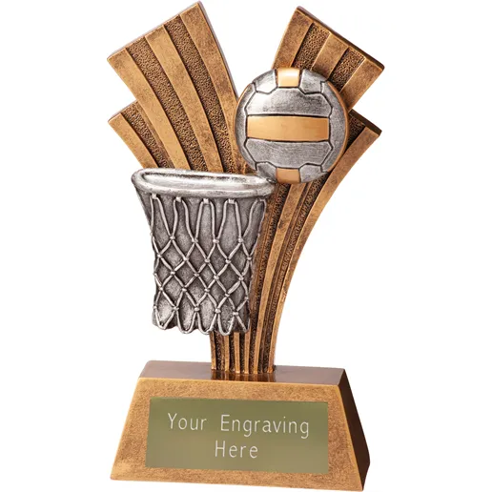
Olney Netball Club AWARDS 2022-2023
Notes:
KARENA
Now it’s time for our annual awards and I’m going to invite the coaches/captains to hand out that team’s awards, sponsored by the Cherry Tree.

Slide 29
U11 Awards Year 5s
Most Improved:
Rosie Sallabank
Coach’s Player:
Betsy Collins
Players Player:
Eloise Winter

Slide 30
Under 11s Awards Year 6s
Most Improved
Ava Gascoyne
Coach’s Player
Isabelle Sceats
Players Player
Brooke Parker

Slide 31
U12 Awards
Most Improved:
Maya Patel
Coach’s Player:
Emily Fitzgerald
Players Player:
Maya Patel

Slide 32
U13 (U14 Galaxy) Awards
Most Improved:
Amelie Benson
Coach’s Player:
Lily Newberry
Players Player:
Arabella Soul

Slide 33
U14 Meteors Awards
Most Improved:
Tilly Tompkins
Coach’s Player:
Jasmine Butler
Players Player:
Martha Donaghy

Slide 34
U16 Meteors Awards
Most Improved:
Katie King
Coach’s Player:
Connie Keeping
Players Player:
Cerys Mather

Slide 35
Seniors Awards
Most Improved:
Millie Corley
Coach’s Player (Purple):
Maddie Murphy
Coach’s Player (White):
Liberty Young
Players’ Player (Purple):
Maddie Murphy
Players Player (White):
Millie Corley
Notes:
We have selected the most improved across the whole senior squad and then have Coach’s player and PP for each of Purple and white.
Most Improved: The winner is the same player as last year, because she has continued to develop her game and her strengths, picking up interceptions, blocking her player out of the game and using her speed to attack through court.
resulting in a number of Player of the Match awards from the opposition. Well done Millie.
Coach’s Player White: this player is awesome. She has such attack and drive and is always moving to be available in the circle and her finishing is sublime. Ably assisted by her sister’s great feeding, it’s Liberty Young.
Coach’s player Purple: Maddie Murphy
Players’ Player for Olney White: Millie Corley
Players’ Player for Olney Purple: Maddie Murphy

